Slide 1

AJAX
HTTP, Firebase, AJAX Concepts
SoftUni Team
Technical Trainers
Software University
https://softuni.bg

Slide 2
Table of Contents
The HTTP Overview
HTTP Developer Tools
Firebase
AJAX
Fetch API

Slide 3
Have a Question?
sli.do #js-front-end

Slide 4

HTTP Protocol
HTTP Overview

Slide 5



HTTP Basics
HTTP (Hyper Text Transfer Protocol)
Text-based client-server protocol for the Internet
For transferring Web resources (HTML files, images, styles, etc.)
Request-response based
HTTP request
HTTP response
Web Client
Web Server

Slide 6






HTTP Request Methods
HTTP defines methods to indicate the desired action to be performed on the identified resource
Method | Description
GET | Retrieve / load a resource
POST | Create / store a resource
PUT | Update a resource
DELETE | Delete (remove) a resource
PATCH | Update resource partially
HEAD | Retrieve the resource's headers
OPTIONS | Returns the HTTP methods that the server supports for the specified URL

Slide 7
HTTP GET Request – Example
GET /users/testnakov/repos HTTP/1.1
Host: api.github.com
Accept: */*
Accept-Language: en
Accept-Encoding: gzip, deflate
User-Agent: Mozilla/5.0 (Windows NT 10.0; WOW64) AppleWebKit/537.36 (KHTML, like Gecko) Chrome/54.0.2840.71 Safari/537.36
Connection: Keep-Alive
Cache-Control: no-cache
<CRLF>
HTTP request line
HTTP headers
The request body is empty

Slide 8
HTTP POST Request – Example
POST /repos/testnakov/test-nakov-repo/issues HTTP/1.1
Host: api.github.com
Accept: */*
Accept-Language: en
Accept-Encoding: gzip, deflate
User-Agent: Mozilla/4.0 (compatible;MSIE 6.0; Windows NT 5.0)
Connection: Keep-Alive
Cache-Control: no-cache
<CRLF>
{"title":"Found a bug",
"body":"I'm having a problem with this.",
"labels":["bug","minor"]}
<CRLF>
HTTP request line
HTTP headers
The request body holds the submitted data

Slide 9
HTTP Response – Example
HTTP response status line
HTTP/1.1 200 OK
Date: Fri, 11 Nov 2016 16:09:18 GMT+2
Server: Apache/2.2.14 (Linux)
Accept-Ranges: bytes
Content-Length: 84
Content-Type: text/html
<CRLF>
<html>
<head><title>Test</title></head>
<body>Test HTML page.</body>
</html>
HTTP response headers
HTTP response body

Slide 10
HTTP Response Status Codes
Status Code | Action | Description
200 | OK | Successfully retrieved resource
201 | Created | A new resource was created
204 | No Content | Request has nothing to return
301 / 302 | Moved | Moved to another location (redirect)
400 | Bad Request | Invalid request / syntax error
401 / 403 | Unauthorized | Authentication failed / Access denied
404 | Not Found | Invalid resource
409 | Conflict | Conflict was detected, e.g. duplicated email
500 / 503 | Server Error | Internal server error / Service unavailable

Slide 11
Content-Type and Disposition
The Content-Type / Content-Disposition headers specify how the HTTP request / response body should be processed
JSON-encoded data
Content-Type: application/json
UTF-8 encoded HTML page. Will be shown in the browser
Content-Type: text/html; charset=utf-8
Content-Type: application/pdf
Content-Disposition: attachment; filename="Financial-Report-April-2016.pdf"
This will download a PDF file named Financial-Report-April-2016.pdf

Slide 12

Chrome Dev Tools, Fiddler, Postman
HTTP Developer Tools

Slide 13
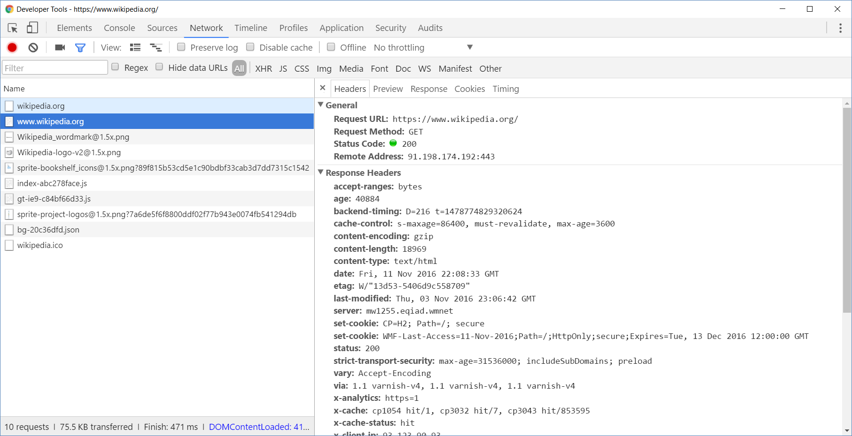
Chrome Developer Tools
Read more about Chrome Developer Tools

Slide 14

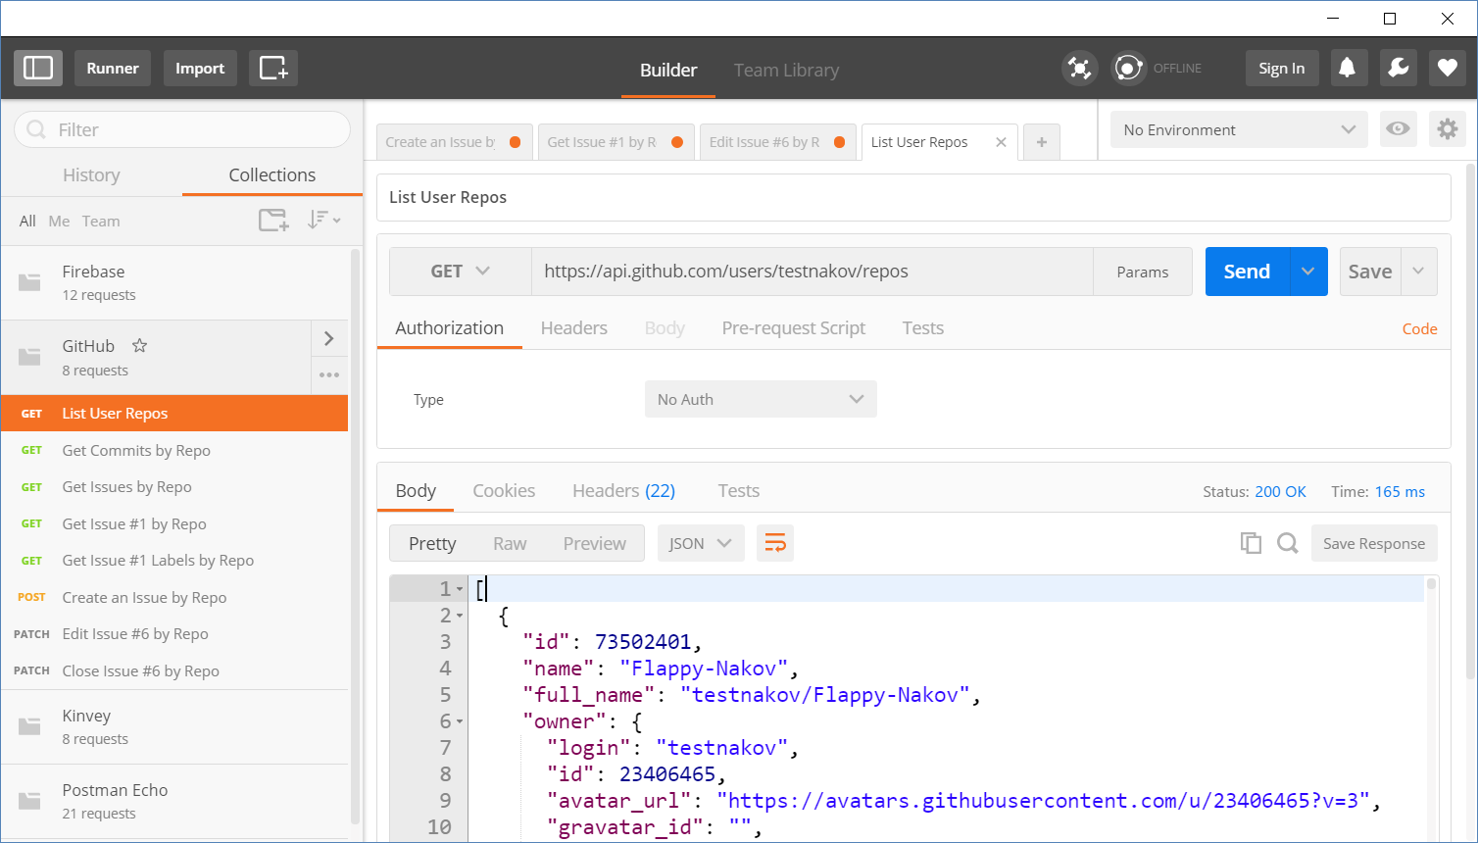
Postman
Read more about Postman REST Client

Slide 15

Mobile Back-End As a Service
Firebase

Slide 16

Introduction to Firebase
A web application always has a Front-End part and a Back-End part.
Each side may be simulated depending on the application.
MBaaS helps simulate the Back-End part of an application.
Offers a back-end platform which you can consume.
Offers a data storage service.
Offers implemented functionality and security.

Slide 17
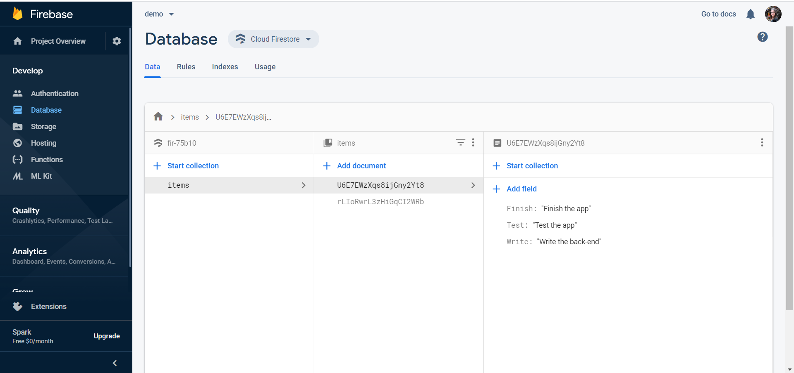
Introduction to Firebase
Mobile and web application development platform.
Offers many services that make application development smooth and easy:
Analytics
Cloud Messaging
Authorization
Database & Storage
Hosting

Slide 18
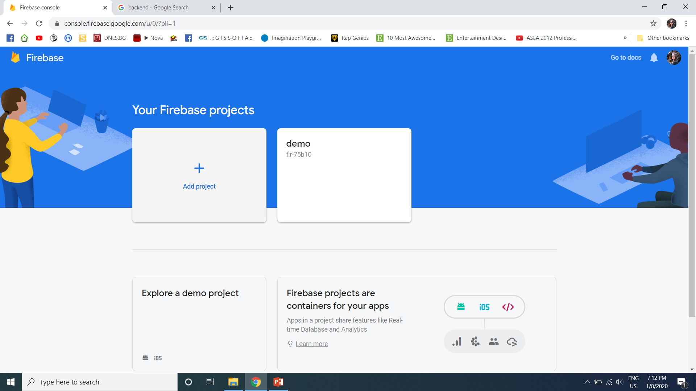
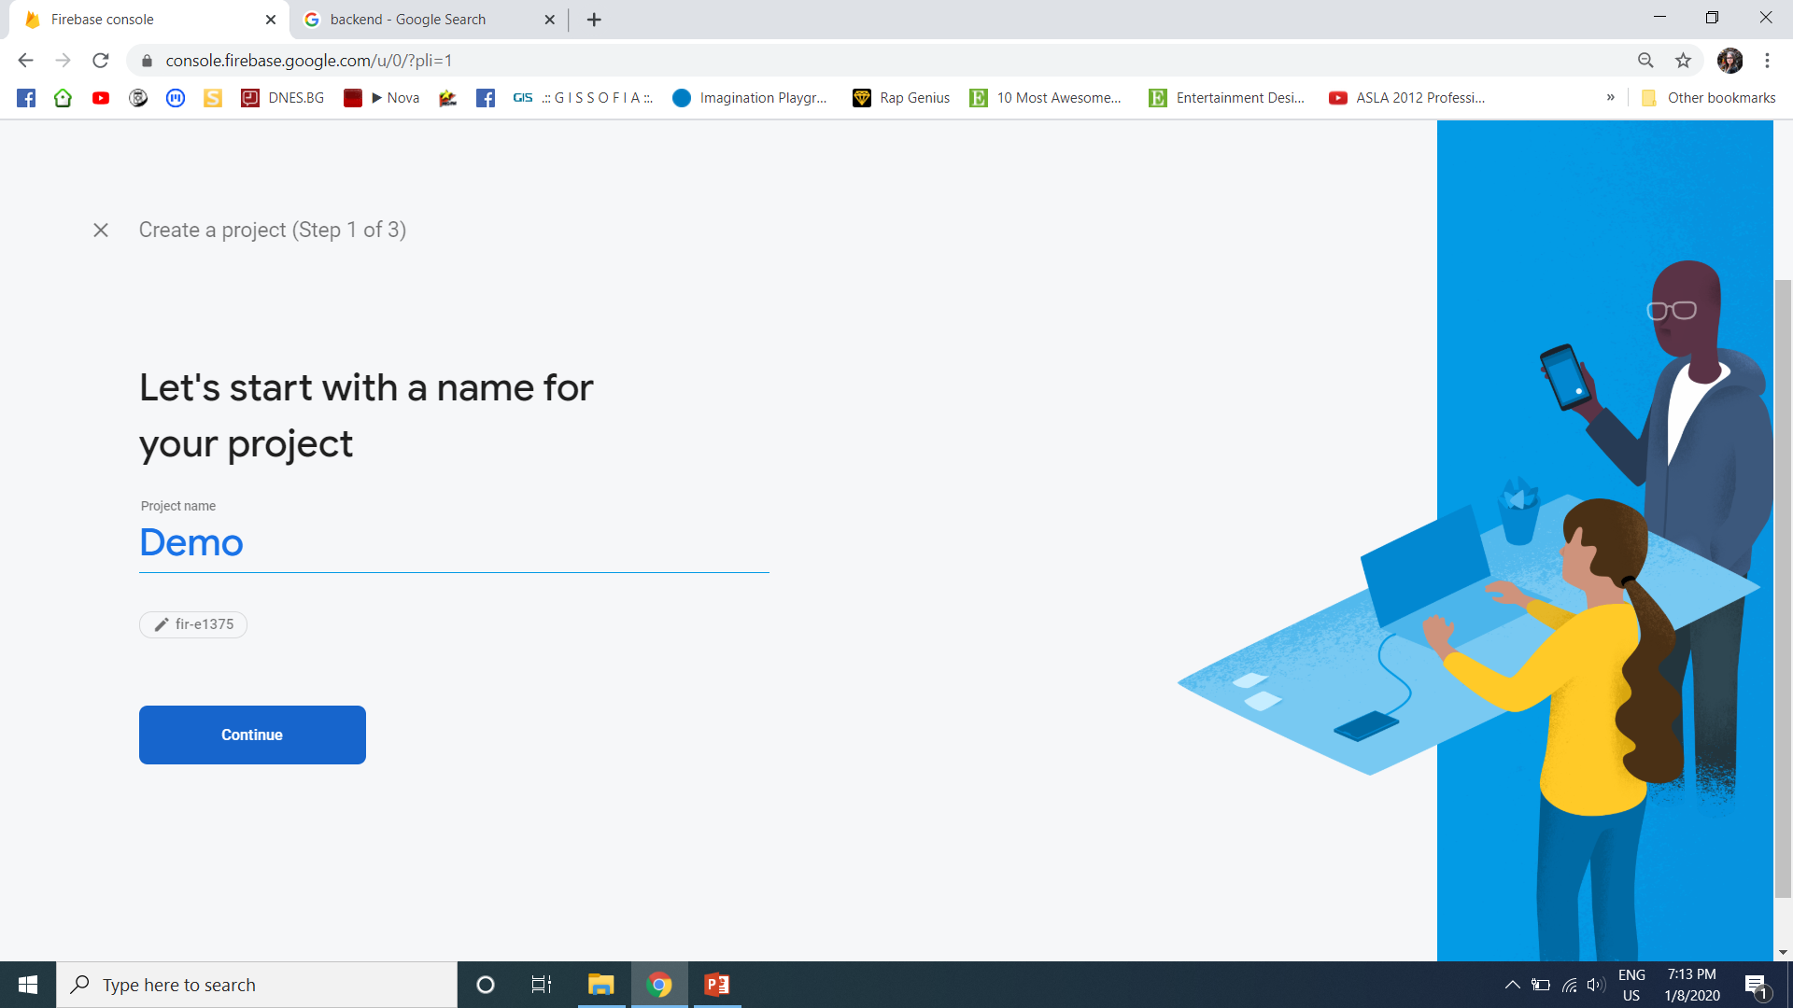
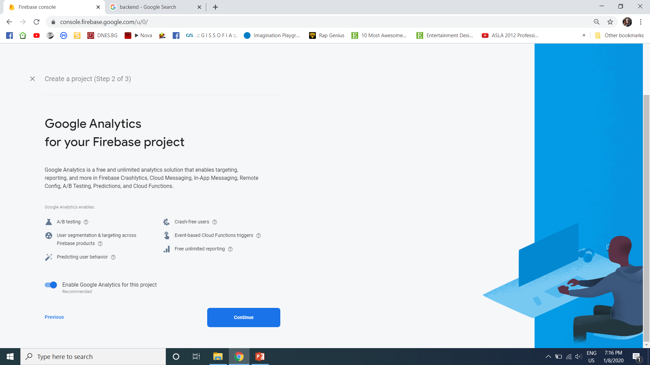
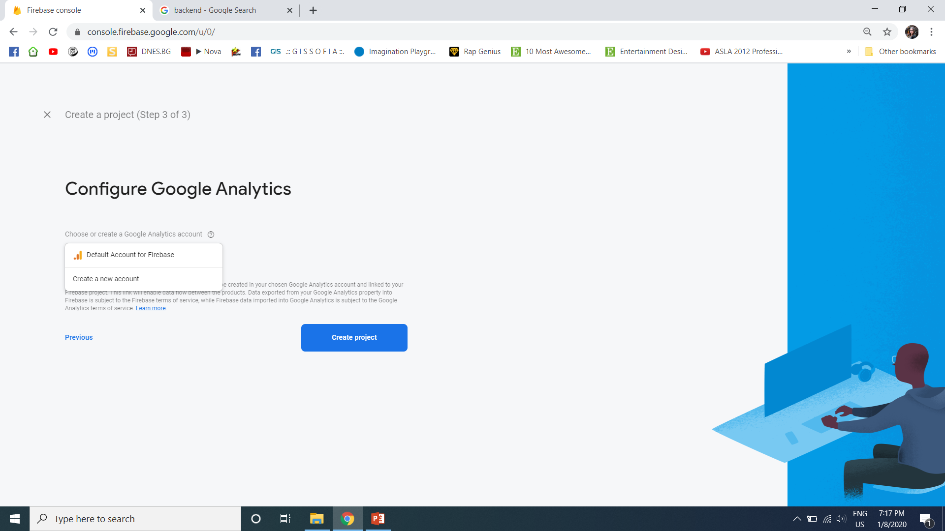
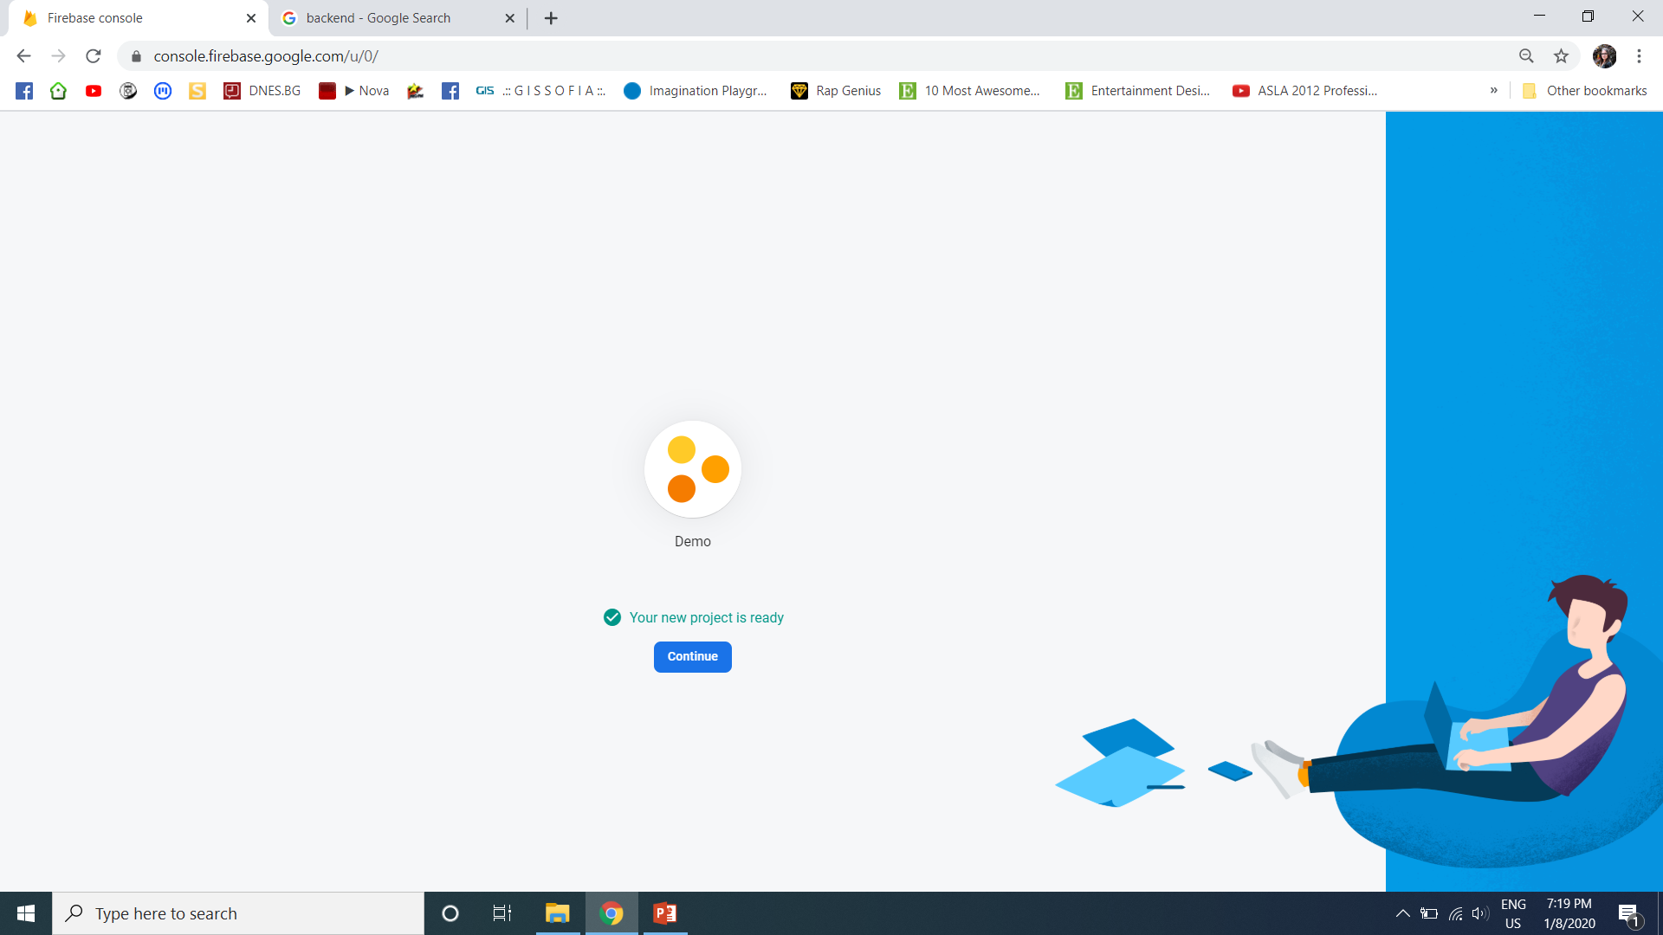
Solution: Setup a Firebase DB
Open https://console.firebase.google.com/
Create a new project

Slide 19
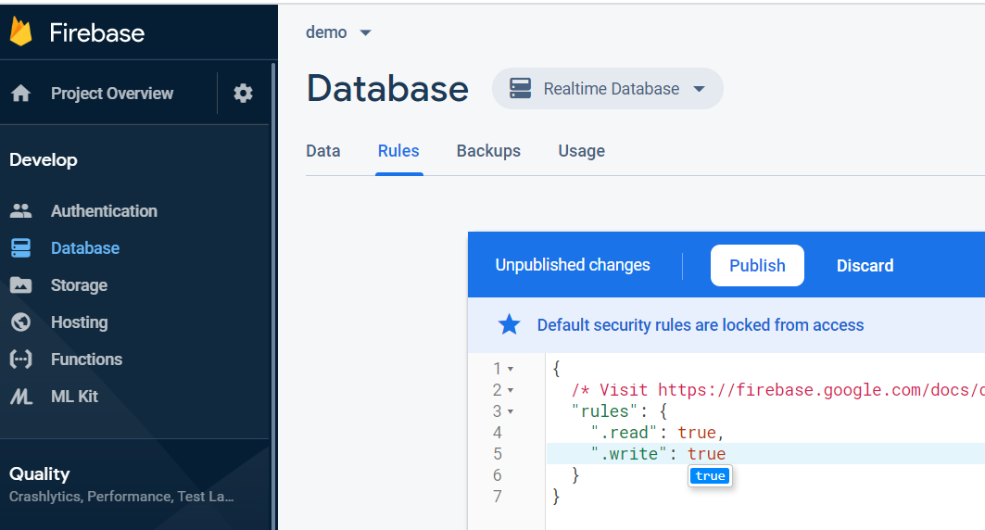
Solution: Setup a Firebase DB
Enable public read / write access

Slide 20
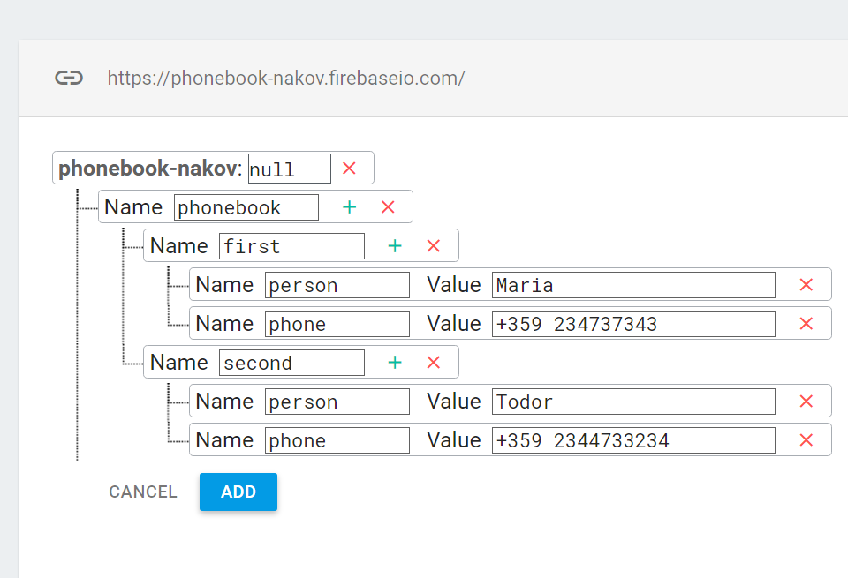
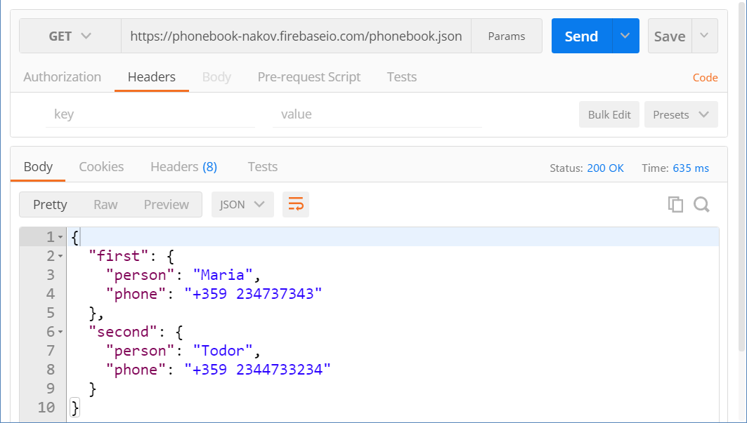
Solution: Add Data and Test
Add Sample Data in Firebase
Test Your REST Service

Slide 21
Asynchronous JavaScript and XML
A AX
AJAX

Slide 22
What is AJAX?
Asynchronous JavaScript and XML
Background loading of dynamic content/data
Load data from the Web server and render it
Two types of AJAX
Partial page rendering
Load HTML fragment + show it in a <div>
JSON service
Loads JSON object and displays it

Slide 23

AJAX: Workflow
1. HTTP request (initial page load)
2. HTTP response (HTML page)
AJAX request
UI Interaction
AJAX response (asynchronous)
AJAX handler
Returns data as JSON / HTML
Web Client
Web Server
Modify the page DOM

Slide 24
Using the XMLHttpRequest Object
AJAX request
AJAX response
Web Client
Web Server

Slide 25
Problem: XHR (XmlHttpRequest)
<button id = "load">Load Repos</button>
<div id="res"></div>
let button = document.querySelector("#load");
button.addEventListener('click', function loadRepos() {
let url = 'https://api.github.com/users/testnakov/repos';
const httpRequest = new XMLHttpRequest();
httpRequest.addEventListener('readystatechange', function () {
if (httpRequest.readyState == 4 && httpRequest.status == 200) {
document.getElementById("res").textContent = httpRequest.responseText;
}
});
httpRequest.open("GET", url);
httpRequest.send();
});
Notes:
Check this slides code -> I think it can be optimized

Slide 26
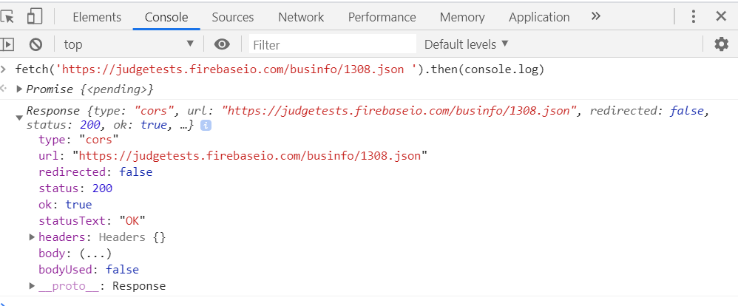
What is Promise?
An object returned by an asynchronous function
Represents the eventual completion or failure of an asynchronous operation

Slide 27
What is Fetch?
The fetch() method allows making network requests
It is similar to XMLHttpRequest (XHR). The main difference is that the Fetch API:
Uses Promises
Enables a simpler and cleaner API
Makes code more readable and maintainable
fetch('./api/some.json')
.then(function(response) {…})
.catch(function(err) {…})

Slide 28
Basic Fetch Request
The response of a fetch() request is a Stream object
The reading of the stream happens asynchronously
When the json() method is called, a Promise is returned
The response status is checked (should be 200) before parsing the response as JSON
if (response.status !== 200) {
// handle error
}
response.json()
.then(function(data) { console.log(data)})

Slide 29
Chaining Promises
When working with a JSON API, you can:
Define the status and JSON parsing in separate functions
The functions return promises which can be chained
fetch('users.json')
.then(status)
.then(json)
.then(function(data) {…})
.catch(function(error) {…});

Slide 30
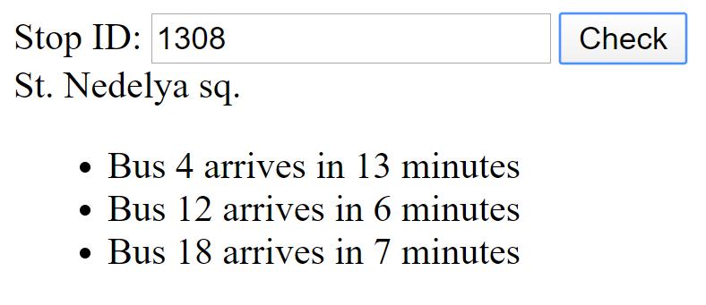
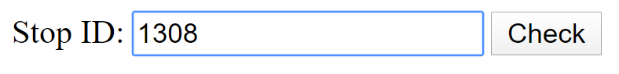
Problem: Bus Stop
When [Check] is clicked, the name of the bus stop appears and all the buses that are expected and their time of arrival
Submit a GET request to https://judgetests.firebaseio.com/businfo/{stopId}.json

Slide 31
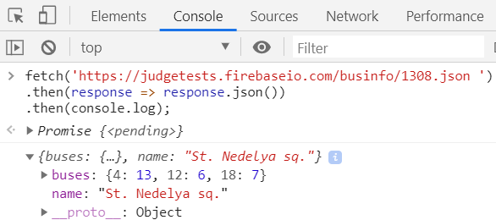
Solution: Bus Stop
function getBusStopInfo() {
const inputValue = document.getElementById('stopId').value;
const stopName = document.getElementById('stopName');
const busContainer = document.getElementById('buses');
const url = `https://judgetests.firebaseio.com/businfo/${inputValue}.json`
fetch(url)
.then((response) => response.json())
.then(handleSuccess)
.catch(handleError)
//…

Slide 32
Solution: Bus Stop
function handleSuccess(data) {
stopName.value = '';
busContainer.textContent = '';
stopName.textContent = data.name;
Object.entries(data.buses)
.forEach(([busNumber, busTime]) => {
let listItem = document.createElement('li');
listItem.textContent = `Bus ${busNumber} arrives in ${busTime} minutes`;
busContainer.appendChild(listItem);
});
}
function handleError() {
stopName.textContent = 'Error!';
} }

Slide 33
GET Request
Fetch API uses the GET method so that a direct call would be like this
fetch('https://swapi.co/api/people/4')
.then((response) => response.json())
.then((data) => console.log(JSON.stringify(data)))
.catch((error) => console.error(error))

Slide 34
POST Request
To make a POST request, we can set the method and body parameters in the fetch() options
fetch('/url', {
method: 'post',
headers: { 'Content-type': 'application/json' },
body: JSON.stringify(data),
})

Slide 35
Body Methods
clone() - create a clone of the response
json() - resolves the promise with JSON
redirect() - create new promise but with different URL
text() - resolves the promise with string

Slide 36
Response Types
basic - normal, same origin response
cors - response was received from a valid cross-origin request
error - error network
opaque - Response for "no-cors" request to cross-origin resource

Slide 37

Summary
…
…
…
HTTP is text-based request-response protocol
Firebase is a mobile and web application
AJAX background loading of dynamic content
XMLHttpRequest
Fetch API

Slide 38
Questions?
Notes:
38

Slide 39












SoftUni Diamond Partners

Slide 40




SoftUni Organizational Partners

Slide 41
Trainings @ Software University (SoftUni)
Software University – High-Quality Education, Profession and Job for Software Developers
softuni.bg, softuni.org
Software University Foundation
softuni.foundation
Software University @ Facebook
facebook.com/SoftwareUniversity
Software University Forums
forum.softuni.bg
Notes:
41

Slide 42

License
This course (slides, examples, demos, exercises, homework, documents, videos and other assets) is copyrighted content
Unauthorized copy, reproduction or use is illegal
© SoftUni – https://softuni.org
© Software University – https://softuni.bg
Notes:
42

